Slide 1
AIM: How did the Neolithic Revolution change how civilizations develop?
Do Now: Answer one of the following
1. Examine the pictures and complete the following sentences.
I see…
I think…
I wonder...
HW: Due Monday:
Complete DBQ 3 and 4 Write a paragraph describing the Neolithic Age. Explain two impacts using information from the documents.

Slide 2
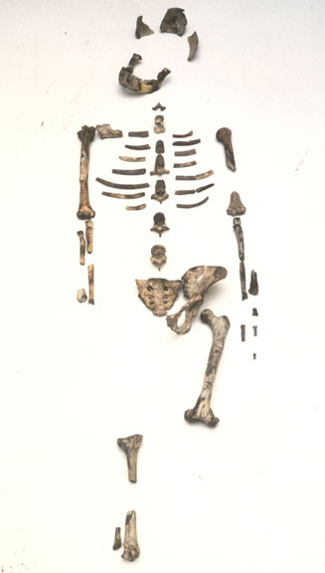
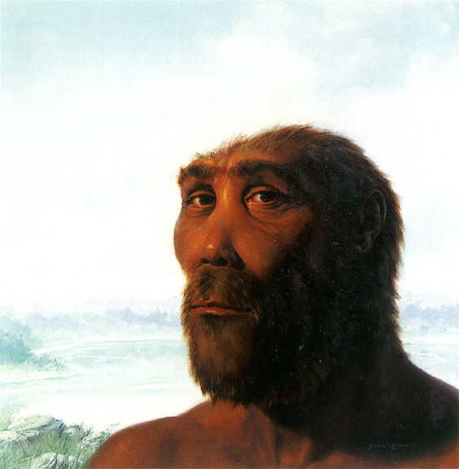
Early Man

Slide 3
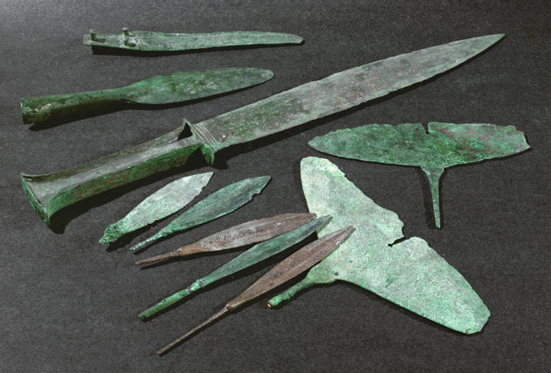
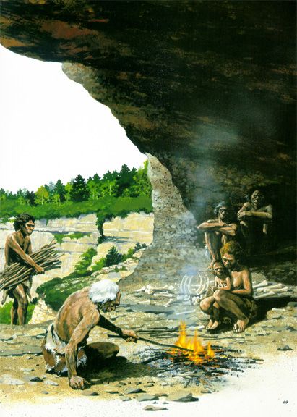
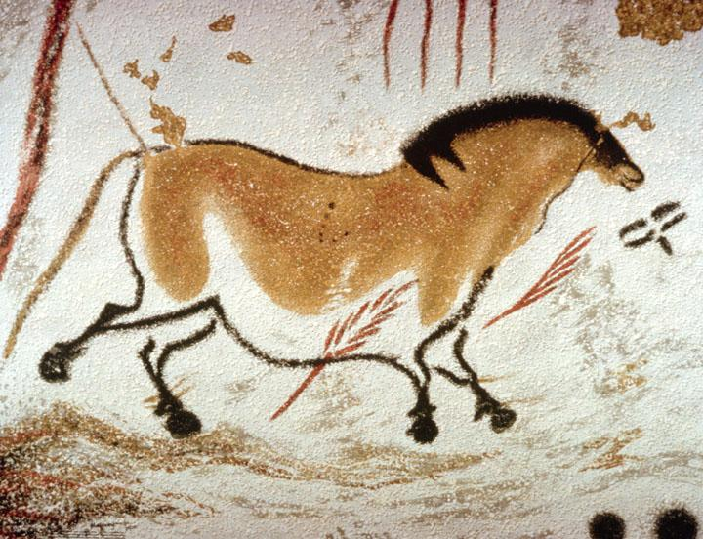
Notes:
see think

Slide 4
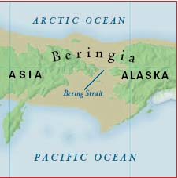
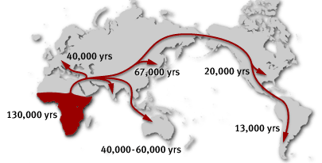
Migration of Man

Slide 5
AIM: How did the Neolithic Revolution change how civilizations develop?
1. What information are archeologist able to learn from artifacts?
2.What continent did early man originate (come) from

Slide 6
Prehistory
Paleolithic Age – Old Stone Age (Est. 2 mil BC-9000 BC)
Hunters & Gatherers
Nomad: Moving from place to place in search for food.
Men → hunted & fished.
Woman → gathered fruits, nuts, etc.
Way of Life
Cave paintings
Stone tools & pottery
Domesticated dogs

Slide 7
Prehistory
Neolithic Age – New Stone Age (9000 BC – 3000 BC)
Farming → Neolithic Revolution
People could remain in one place.
Herding of animals – goats, sheep & cattle.
Communities developed.
.

Slide 8
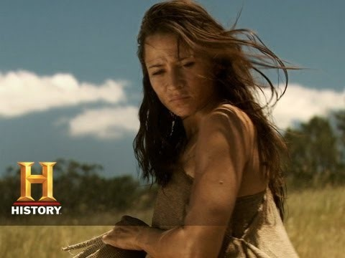
The Birth of Farming
What is one reason people began to farm?
Describe two impacts of farming on our world.

Slide 9
Cause and Effects of the Neolithic Revolution
List one cause of the Neolithic Revolution.
List 1 immediate effect
List 1 long term effect.

Slide 10
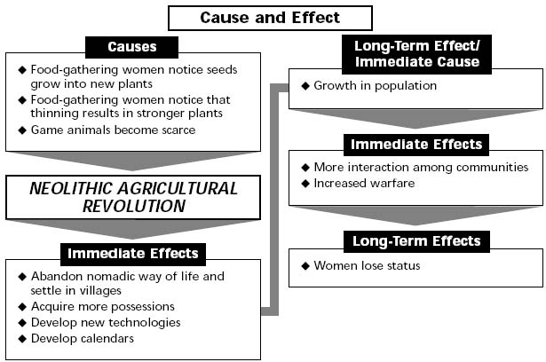
The Neolithic Revolution

Slide 11
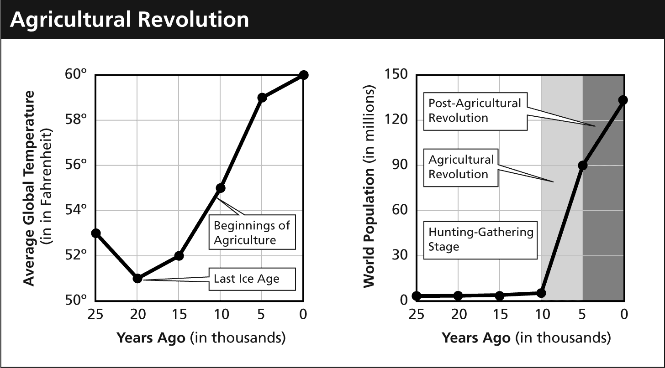
Effects of Farming

Slide 12
Answering a DBQ
Read the questions.
Read the text.
Underline important information
Make notes in the margin (anotate.)
Underline vocabulary words that are connected to the lesson/what you studied in class.

